Slide 1

Intro to Timing Attacks
Swearingen 2A14 @ 6:30PM
Thursday, March 28
William Edwards

Slide 2
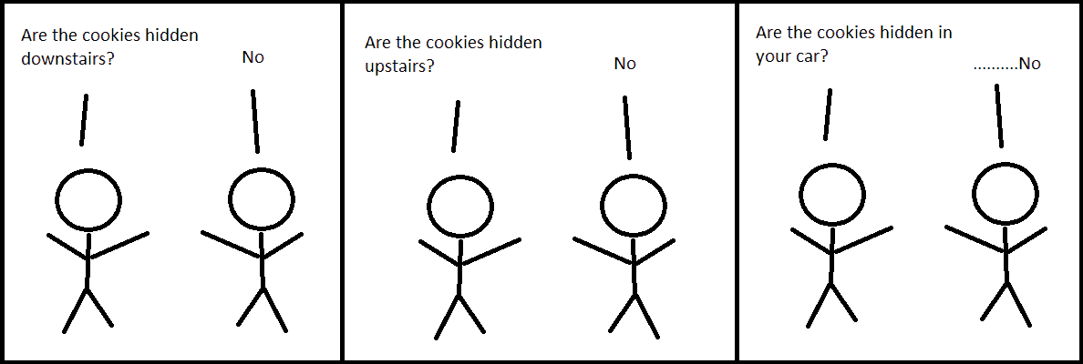
Background
Programs take different amounts of time to run depending on the inputs.
Sometimes this can be revealing.

Slide 3
Basic Example
secret_password = “pasword1234”
if (“password1235” == secret_password):
# Grant Access
if (“secret1235” == secret_password):
# Grant Access

Slide 4
More Complex Example
function modular_pow(base, exponent, modulus)
if modulus = 1 then return 0
Assert :: (modulus - 1) * (modulus - 1) does not overflow base
result := 1
base := base mod modulus
while exponent > 0
if (exponent mod 2 == 1):
result := (result * base) mod modulus
exponent := exponent >> 1
base := (base * base) mod modulus
return result

Slide 5

Real-World Examples
Unix Crypt/login
Extract list of vulnerabilities
2003 SSL Attack, Boneh and Brumley
Recovered private keys from servers in hours.
Meltdown and Spectre
Cache Timing

Slide 6
Demo Time!
https://github.com/williamedwards/timing-attack

Slide 7
Mitigation
Constant time code
Isn’t easy to write
Compiler optimization is not your friend
Adding random jitter
Makes analysis harder but not impossible.

Slide 8
Takeaways
Statistical analysis is a powerful tool.
Rolling your own security is a bad idea.

Slide 9
Questions?

